Slide 1
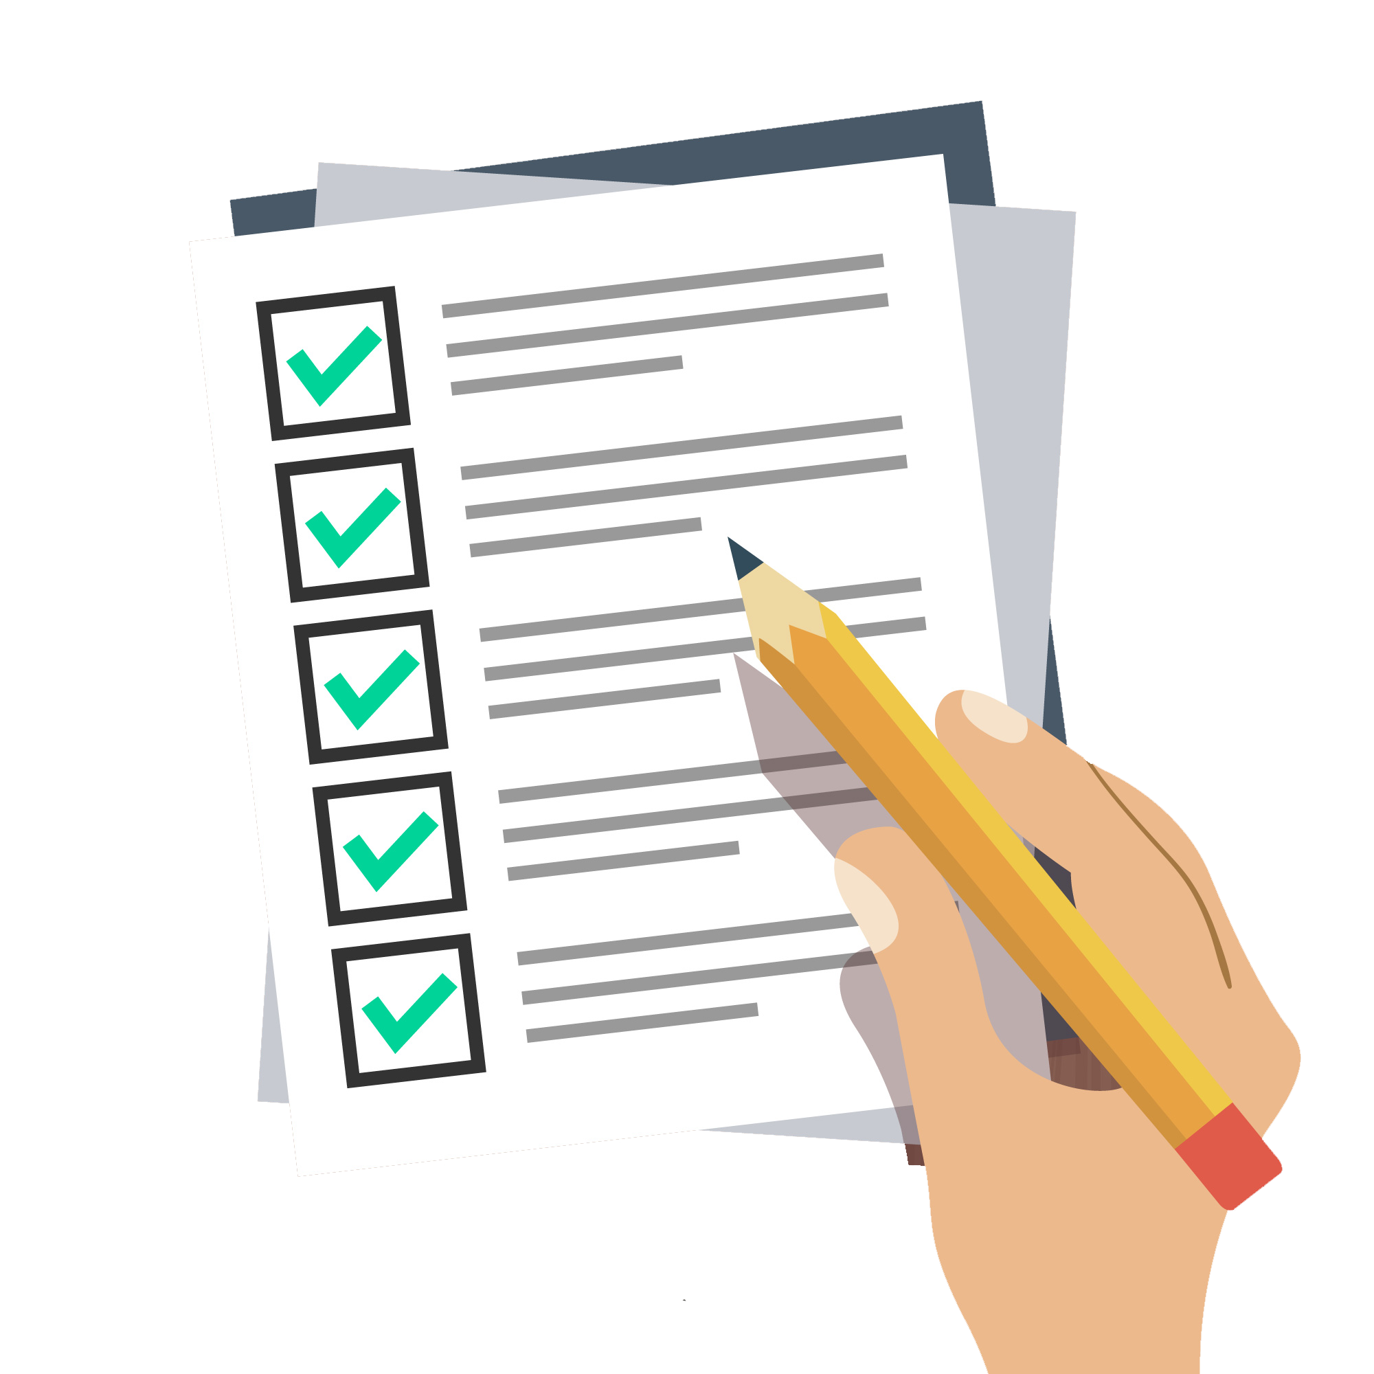
Exam Preparation
SoftUni Team
Technical Trainers
Software University
https://about.softuni.bg

Slide 2
Have a Question?
sli.do
#Agile
Notes:
2

Slide 3
Table of Contents
Exam Info
Exam Preparation
Q&A
3
Notes:
3

Slide 4
Еxam Info
Exam and Evaluation Criteria

Slide 5

Exam Dates
Regular Exam: 18 November 2023
Retake Exam: 25 November 2023

Slide 6
Test
60
minutes
20
single-choice question

Slide 7


Scoring
TEST
100 pts.
EVALUATION
CRITERIA

Slide 8
Exam
Test – 60 minutes
English
Automated quiz system
Practical and theoretical questions
You can submit your answers just one time

Slide 9
Еxam Preparation

Slide 10
Overview
Overview of the material
Sample questions
Q&A

Slide 11
Project Management Framework
A project, by definition, has the following characteristics
It is temporary – with a beginning and an end
It creates/delivers a unique product, service or result

Slide 12
Classic approach
12
Predefined project goal, known and elaborated scope and deliverables
Plan-driven approaches require more information to be known up-front
Monitoring and Controlling
Planning
Initiating
Closing
Executing

Slide 13
Organizational Structure Types
Functional
Projectized
Matrix

Slide 14
Functional Organization
Employees are grouped by specialization
Accounting, marketing, etc.
Governed by a Functional manager
Projects within a single department
Project work in addition to normal work
Executive
Functional Manager
Functional Manager
Functional Manager
Staff
Staff
Staff
Staff
Staff
Staff

Slide 15
Projectized Organization
The company is organized by projects
The PM has full authority
Employees report to the PM
Only project work is done
Executive
Project Manager
Project Manager
Project Manager
Staff
Staff
Staff
Staff
Staff
Staff

Slide 16
Matrix Organization
A blend of functional and projectized
High level of coordination is required
Communication to both PM and
Functional Manager
Executive
Department Manager
Functional Manager
Functional Manager
Staff
Project manager
Staff
Staff
Staff
Staff

Slide 17
Waterfall vs Agile
Command-and-control powerment

Slide 18

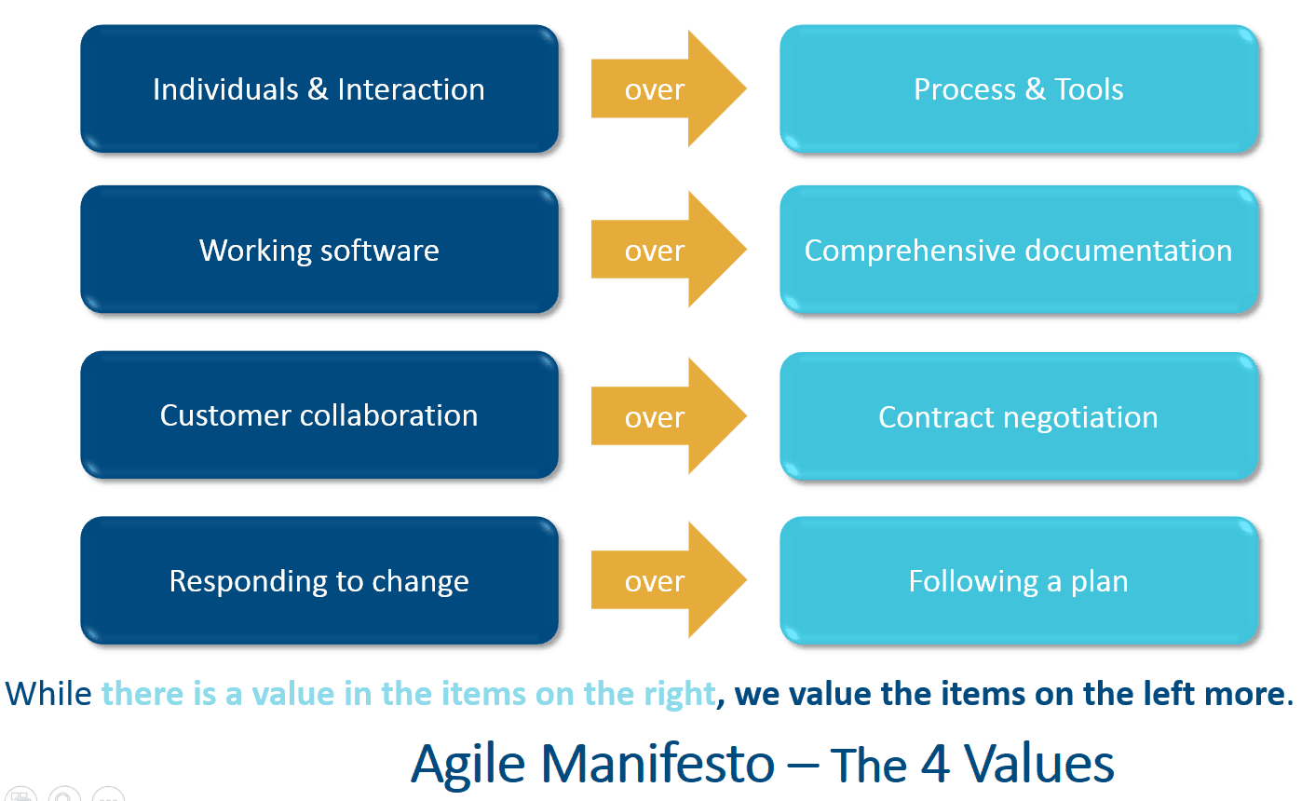
Agile Manifesto

Slide 19
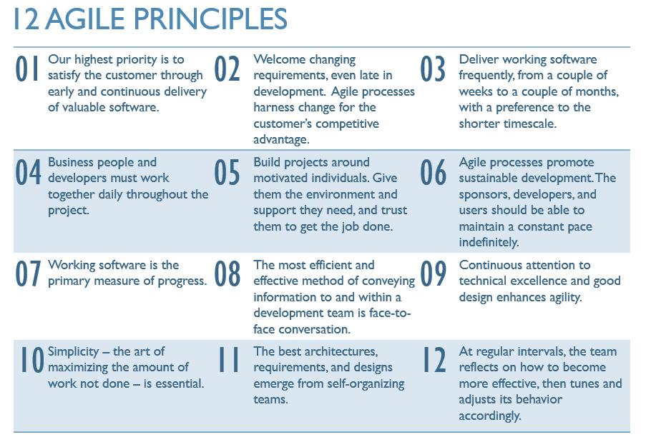
Agile Manifesto

Slide 20
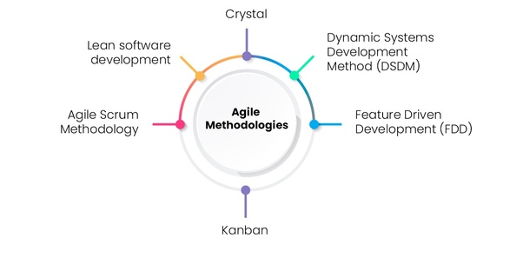
Agile Frameworks
Lean Methodology
(eliminate waste from a process)

Slide 21
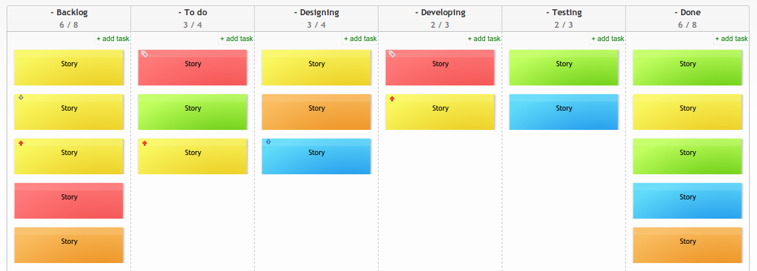
Kanban Board – Basics

Slide 22
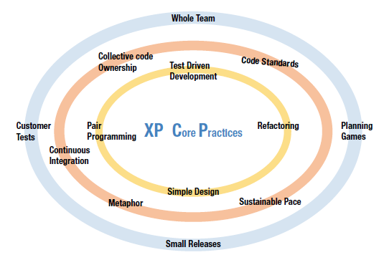
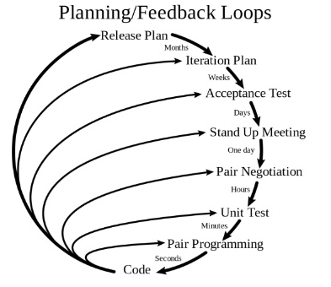
Extreme Programming
Coaching role, no SM

Slide 23
Q1
Ash is working on an XP project. When his manager stops by to check on the progress, she notices that the developers are working in groups of two, rather than individually. This approach is called what?
P2P (Programmer – Programmer)
Pared programming
People-People Programming
Pair Programming
Notes:
XP utilizes pair programming: when one developer codes and the second developer checks the code; it’s the correct answer. The other responses are incorrect because they are not valid descriptions of pair programming in XP.

Slide 24
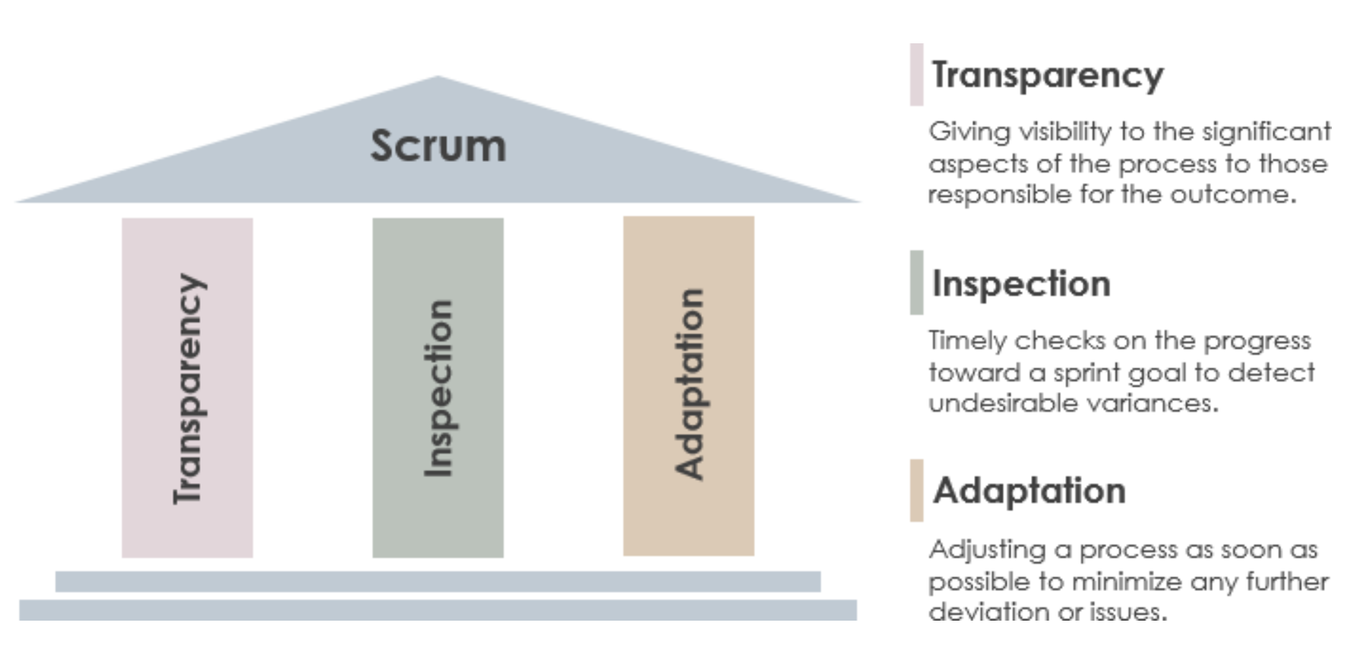
SCRUM

Slide 25
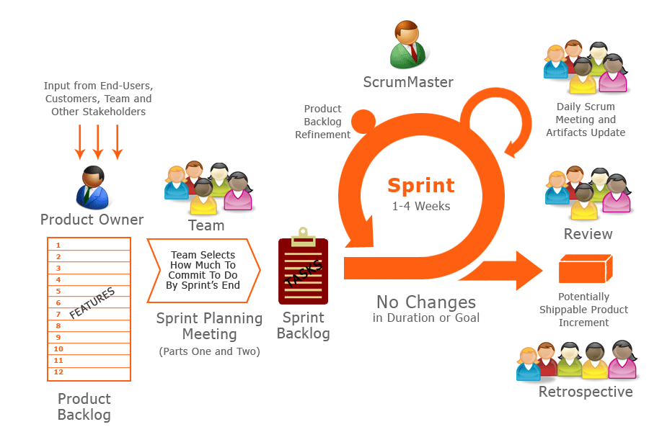
SCRUM BASICS
Notes:
The longer high-value features take to deliver, the longer the opportunity for risks that can reduce value. Before things start to change, maximize success by providing as many high-value features as possible. Value-driven delivery means making decisions that prioritize the value-added activities and risk-reducing efforts of the project. Then, based on those priorities, accomplish the tasks. The other responses are incorrect. The goal isn’t to merely get features out of the way, but to deliver value based on the prioritized backlog. Delivering the most intense tasks first won’t necessarily shorten the project time, nor will it support completing the requirements with the most value. Finally, while understanding value is essential, this doesn’t best answer the question as delivering value.

Slide 26
Q2
Raj is educating the project team and key stakeholders about Scrum. A few of the team members are confused about the activities that happen after the sprint review. Raj should indicate which of the following activities is to occur after the sprint review?
Product backlog refinement
Sprint planning meeting
Daily Scrum
Sprint retrospective
Notes:
Sprint retrospective is the correct answer. To gather lessons learned and look for improvement opportunities, a sprint retrospective should be held after a sprint review but before a sprint planning meeting. This activity allows the team to consider feedback from the owner, and also implement improvements before the next sprint. The other answers are incorrect: product backlog refinement occurs in product refinement meetings; sprint planning meetings take place after the product refinement meeting; the Daily Scrum is hosted every day at the same time and same place.

Slide 27
Story Points
Effort
Complexity
Uncertainty

Slide 28
Story Points
What are "story points"?
In short, "story points" are the units of measure used in Scrum
Relative sizing/estimates
Story point estimates need to include all known activities required to complete the story, including testing and refactoring, complexity level, risk level, etc.
How is Poker Planning done? What's the process when there's no consensus reached?

Slide 29
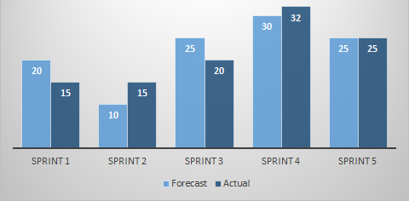
Velocity
Team's capacity for an iteration – measured in story points

Slide 30
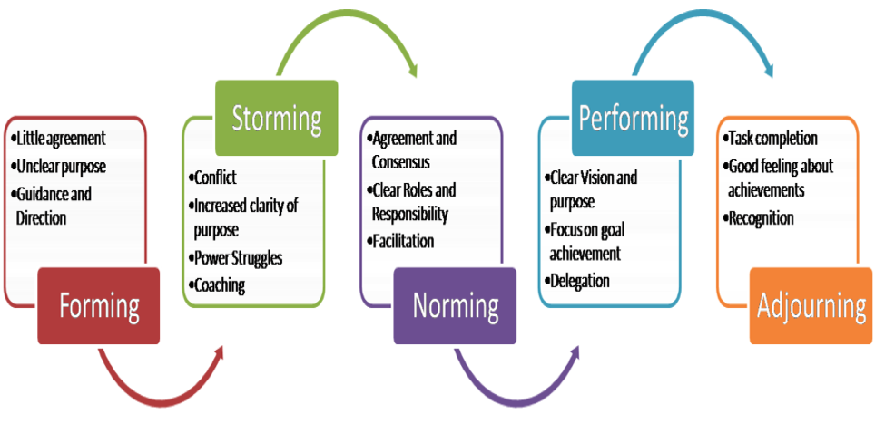
Tuckman's Model

Slide 31
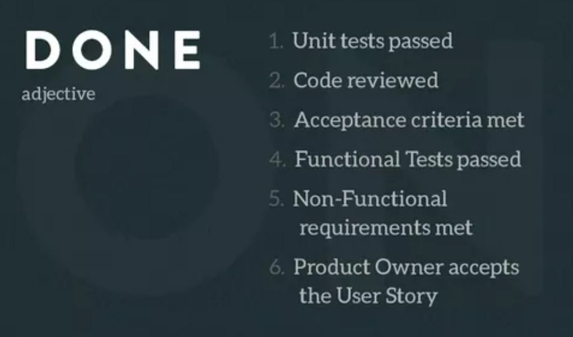
Definition of Done
The Definition of Done (DoD) is based on the agreed criteria that must be met for a team to consider an aspect of the product shippable or complete
It established a shared understanding across the team what must be done for a user story to be considered finished

Slide 32
Value Metrics
Agile backlogs are prioritized not only for features but also for risk responses to identified risks
When planning an iteration, the team balances the delivery of high-value features with the mitigation of the biggest project risks
Feature 1
Risk response
Risk response
Feature 2
Feature 3
Feature 4
Sprint commitment
Notes:
32

Slide 33
Q3
Anderson's agile team is in the release planning phase for the next iteration. To determine how much work can be done in the next release, what is the most accurate tool to use?
User stories
Affinity estimating
Story points
Velocity
Notes:
Velocity is the correct answer. To plan how much work can be done in the next release, agile typically uses the velocity trend over the last several iterations. Gathering groups of user stories or summing story points factor into the velocity in which iterations are completed. User stories, story points, and affinity estimating are incorrect responses because they are not used to determine the amount of work to be done in the next release of the project.

Slide 34
Key Agile Terms
Generalizing specialists
Servant Leadership
Timeboxing
Inspect and Adapt – set SMART goals
Collocation – 33 feet
Backlog prioritized by business value
Empirical and value-based measurement
Safe environment and constructive conflict

Slide 35
Q4
Clark has been identified as a stakeholder on an agile software development team. When he attends his first meeting, Clark is surprised that there are only ten people on the team; since it’s a large implementation, he thought the team would be much more significant. Why is the team so small?
One person was selected from each department
Agile methods call for very specialized roles
The agile methodology is so new; no one wanted to be on the team
The agile method recommends the delivery team to have 12 or fewer members
Notes:
For team members to form relationships and communicate directly, agile methods recommend assembling a team of 12 or less. If more team members are needed, teams can be broken down into subgroups and their work will be coordinated. The selection of agile team members is based on their ability to commit to a common purpose, agree on goal measurement, and take shared ownership of the project. The other responses are incorrect. The newness of the agile approach is an organization is not the best choice for the team size limit; agile teams are chosen by skill level, not by representatives from each department; agile methods call for generalizing specialists on the project team.

Slide 36
Q5
For team members to form relationships and communicate directly, agile methods recommend assembling a team of 12 or less. If more team members are needed, teams can be broken down into subgroups and their work will be coordinated. The selection of agile team members is based on their ability to commit to a common purpose, agree on goal measurement, and take shared ownership of the project. The other responses are incorrect. The newness of the agile approach is an organization is not the best choice for the team size limit; agile teams are chosen by skill level, not by representatives from each department; agile methods call for generalizing specialists on the project team.
Bonnie is working in an agile team who has identified the highest-value features of the project and wants to deliver them immediately. Why is this a good idea?
Delivering the most intense tasks could shorten the project duration
It proves the team's understanding of value
The longer the project goes on, the value of a feature may be compromised
It gets the features out of the way
Notes:
The longer high-value features take to deliver, the longer the opportunity for risks that can reduce value. Before things start to change, maximize success by providing as many high-value features as possible. Value-driven delivery means making decisions that prioritize the value-added activities and risk-reducing efforts of the project. Then, based on those priorities, accomplish the tasks. The other responses are incorrect. The goal isn’t to merely get features out of the way, but to deliver value based on the prioritized backlog. Delivering the most intense tasks first won’t necessarily shorten the project time, nor will it support completing the requirements with the most value. Finally, while understanding value is essential, this doesn’t best answer the question as delivering value.

Slide 37
Q6
For team members to form relationships and communicate directly, agile methods recommend assembling a team of 12 or less. If more team members are needed, teams can be broken down into subgroups and their work will be coordinated. The selection of agile team members is based on their ability to commit to a common purpose, agree on goal measurement, and take shared ownership of the project. The other responses are incorrect. The newness of the agile approach is an organization is not the best choice for the team size limit; agile teams are chosen by skill level, not by representatives from each department; agile methods call for generalizing specialists on the project team.
In his role as a leader, Ash uses several agile tools to find potential problems before they happen. Of the following, which is one of those tools?
Daily standup meetings
Affinity estimating
Iteration planning
User story
Notes:
Daily standup meetings is the correct answer. Daily standup meetings are important tools that identify possible problems by answering the question if there are any roadblocks that need to be removed. The other responses are incorrect. Affinity estimating doesn’t address potential problems but is an approach used to size stories. While user story and iteration planning are valuable tools used to identify problems, the best approach within the agile framework is the daily standup meeting.

Slide 38
Q7
For team members to form relationships and communicate directly, agile methods recommend assembling a team of 12 or less. If more team members are needed, teams can be broken down into subgroups and their work will be coordinated. The selection of agile team members is based on their ability to commit to a common purpose, agree on goal measurement, and take shared ownership of the project. The other responses are incorrect. The newness of the agile approach is an organization is not the best choice for the team size limit; agile teams are chosen by skill level, not by representatives from each department; agile methods call for generalizing specialists on the project team.
During a sprint planning meeting, what is one item that should be accomplished?
Each participant answers three questions: What have I accomplished? What do I plan to accomplish? Are there any roadblocks?
The product owner shared the updated backlog and the team discusses it to make sure everyone understands it before committing to what they can deliver in the next iteration
The product owner decides if the product is done
The project scope and costs are renegotiated
Notes:
The product owner should share the updated backlog items to make sure the entire team understands how to move forward. The other responses are incorrect. The project scope is based on the prioritized requirements; to uncover any obstacles, accomplishment and roadblock questions are answered during Daily Scrums; a project’s success is not discussed in a sprint planning meeting.

Slide 39
Q8
For team members to form relationships and communicate directly, agile methods recommend assembling a team of 12 or less. If more team members are needed, teams can be broken down into subgroups and their work will be coordinated. The selection of agile team members is based on their ability to commit to a common purpose, agree on goal measurement, and take shared ownership of the project. The other responses are incorrect. The newness of the agile approach is an organization is not the best choice for the team size limit; agile teams are chosen by skill level, not by representatives from each department; agile methods call for generalizing specialists on the project team.
In an agile environment, which process sets the stage, gathers data, generates insight, decides what to do, and closes?
Retrospectives
Feedback
Pre-mortems
Value stream mapping
Notes:
The correct answer is retrospectives. Retrospectives follow these five steps (setting the stage, data gathering, insight-generating, what to do, closing) to provide valuable lessons learned from each subsequent iteration. To improve the next iteration’s process, the team can take roadblocks and problems encountered in the iteration, along with their resolutions, and act upon them. The other responses are incorrect because the five steps are not applicable to pre-mortems, value stream mapping, or feedback.

Slide 40
Q9
For team members to form relationships and communicate directly, agile methods recommend assembling a team of 12 or less. If more team members are needed, teams can be broken down into subgroups and their work will be coordinated. The selection of agile team members is based on their ability to commit to a common purpose, agree on goal measurement, and take shared ownership of the project. The other responses are incorrect. The newness of the agile approach is an organization is not the best choice for the team size limit; agile teams are chosen by skill level, not by representatives from each department; agile methods call for generalizing specialists on the project team.
An agile leader must ensure there is a safe and open environment for their team. Why is this important?
So there's no team turnover
To protect the budget
So the entire team becomes friends
So the team feels free to admit to problems and failures and asks for help
Notes:
To reassure team members they won’t be criticized for admitting failure or to a problem, it’s of the utmost importance for the team leader to foster an open and safe environment. Asking for help assists the team in meeting deadlines, avoiding cost overruns, and trying different approaches. The other responses are incorrect. It’s an admirable goal to have little or no team turnover, it’s not the best choice presented here. Additionally, even though some agile projects promote social aspects, friendships among the project team isn’t the best goal (or choice here) of the open and safe environment. Finally, the open and safe environment is not created to protect the budget.

Slide 41
Q10
For team members to form relationships and communicate directly, agile methods recommend assembling a team of 12 or less. If more team members are needed, teams can be broken down into subgroups and their work will be coordinated. The selection of agile team members is based on their ability to commit to a common purpose, agree on goal measurement, and take shared ownership of the project. The other responses are incorrect. The newness of the agile approach is an organization is not the best choice for the team size limit; agile teams are chosen by skill level, not by representatives from each department; agile methods call for generalizing specialists on the project team.
Beatrice is a leader in an agile project. Maximizing value is an agile team's focus. What is the first question that should be asked when the team needs to make a decision?
Will the decision that is made derail the project?
How long will it take to test?
What is the cost in man hours?
What is the value to the customer?
Notes:
The value to the customer is the first question that should be asked in this scenario. The focus on delivering value is what drives many of the decisions and activities on an agile project. In the agile toolkit, this is the goal of many practices. The other responses are incorrect because answers to questions regarding time, impact, and cost will be determined after the customer value is defined.

Slide 42
Q11
For team members to form relationships and communicate directly, agile methods recommend assembling a team of 12 or less. If more team members are needed, teams can be broken down into subgroups and their work will be coordinated. The selection of agile team members is based on their ability to commit to a common purpose, agree on goal measurement, and take shared ownership of the project. The other responses are incorrect. The newness of the agile approach is an organization is not the best choice for the team size limit; agile teams are chosen by skill level, not by representatives from each department; agile methods call for generalizing specialists on the project team.
Who should take responsibility for the process of story point sizing?
The agile team leader
The business partner
The agile team
The PMO
Notes:
The agile team creates and owns the story point sizing process. They are the most qualified to determine the amount of effort needed to complete each story. The other responses are incorrect. The PMO and business partner do not have that level of detail involved in the project. While the agile team leader supports the team in creating the story point sizing, they are not responsible for the task itself.

Slide 43
Q12
For team members to form relationships and communicate directly, agile methods recommend assembling a team of 12 or less. If more team members are needed, teams can be broken down into subgroups and their work will be coordinated. The selection of agile team members is based on their ability to commit to a common purpose, agree on goal measurement, and take shared ownership of the project. The other responses are incorrect. The newness of the agile approach is an organization is not the best choice for the team size limit; agile teams are chosen by skill level, not by representatives from each department; agile methods call for generalizing specialists on the project team.
Because of your work on several agile teams, you've become very familiar with user stories. You've been asked to describe to the new people on your team what a "user story" actually is. In just a few words, how do you explain a user story?
A user story is a small chunk of functionality that can be delivered in one sprint
A user story is a narrative of requirements
A user story is the background of the user community
A user story is how the user community plans to use the product
Notes:
A user story is a small chunk of functionality that can be delivered in one sprint. To define the task in more detail, the user story should answer questions that the team needs to be answered. There are no right or wrong questions (or answers); each team comes up with what best fits their needs. The other responses are incorrect because they are inaccurate descriptions of user stories. Furthermore, the user story has nothing to do with the user community’s background or how it is going to use the deliverable.

Slide 44
Q13
For team members to form relationships and communicate directly, agile methods recommend assembling a team of 12 or less. If more team members are needed, teams can be broken down into subgroups and their work will be coordinated. The selection of agile team members is based on their ability to commit to a common purpose, agree on goal measurement, and take shared ownership of the project. The other responses are incorrect. The newness of the agile approach is an organization is not the best choice for the team size limit; agile teams are chosen by skill level, not by representatives from each department; agile methods call for generalizing specialists on the project team.
Crystal is working with an agile team that is developing and delivering a software solution to her company’s HR group. Throughout the project, many MVP (minimum viable product) releases are scheduled. Why is this a good idea?
To enable the business to begin to get value from the project before the project ending
To shorten the duration of the project
To show the progress being made by the development team
To enable the users to test the product for the development team
Notes:
The correct answer is to enable the business to begin to get value from the project before the project’s end. While the team is developing the remaining functionality, incremental releases may allow for some ROI. The other responses are incorrect. The purpose of releasing MVPs is to deliver value, not to show the project’s progress. The product, in this case, software, should already be thoroughly tested and functional before being released to users. Finally, the duration of the project will not be shortened by releasing MVPs; the MVPs are defined in the project life cycle.

Slide 45
Q14
For team members to form relationships and communicate directly, agile methods recommend assembling a team of 12 or less. If more team members are needed, teams can be broken down into subgroups and their work will be coordinated. The selection of agile team members is based on their ability to commit to a common purpose, agree on goal measurement, and take shared ownership of the project. The other responses are incorrect. The newness of the agile approach is an organization is not the best choice for the team size limit; agile teams are chosen by skill level, not by representatives from each department; agile methods call for generalizing specialists on the project team.
As a new team member working on a Scrum project, Anju is confused about the difference between a sprint review and a sprint retrospective. What is the difference?
Sprint reviews discuss what has worked in the sprint. Sprint retrospectives are done at the end of the project for a lessons learned opportunity.
Sprint reviews demonstrate the completed work in the sprint. Sprint retrospectives demonstrate the compiled work completed in the project.
Sprint reviews are for lessons learned. Sprint retrospectives are for product demonstrations.
Sprint reviews are for product demonstrations. Sprint retrospectives are for lessons learned.
Notes:
The correct answer is that sprint reviews are for product demonstrations; sprint retrospectives are for lessons learned. The other answers are incorrect descriptions of sprint reviews and sprint retrospectives.

Slide 46
Q15
For team members to form relationships and communicate directly, agile methods recommend assembling a team of 12 or less. If more team members are needed, teams can be broken down into subgroups and their work will be coordinated. The selection of agile team members is based on their ability to commit to a common purpose, agree on goal measurement, and take shared ownership of the project. The other responses are incorrect. The newness of the agile approach is an organization is not the best choice for the team size limit; agile teams are chosen by skill level, not by representatives from each department; agile methods call for generalizing specialists on the project team.
Ava and her team are working on a project that has begun following the agile model of the triangle of constraints. Of the following, which is the approach that Ava follows?
The project cycles have a fixed time and fixed scope, but the cost of the finished work within each cycle could vary
Each cycle of the project has a fixed scope, but the timing of the cycles and cost of the completed work within each cycle may vary
Each cycle of the project has a fixed cost and fixed scope, but each cycle’s timing may vary
Each project cycle has a fixed time and fixed cost, but the scope of the finished work within each cycle could vary
Notes:
The correct answer is that each project cycle has a fixed time and fixed cost, but the scope of work completed within each cycle could vary. A model that represents fixed cost and fixed time, but has a variable scope, is an agile triangle of constraints. The other responses are incorrect because a fixed scope represents the established model of the triangle of constraints; fixed time, fixed scope, and fixed cost do not accurately portray the agile triangle of constraints.

Slide 47
Q16
For team members to form relationships and communicate directly, agile methods recommend assembling a team of 12 or less. If more team members are needed, teams can be broken down into subgroups and their work will be coordinated. The selection of agile team members is based on their ability to commit to a common purpose, agree on goal measurement, and take shared ownership of the project. The other responses are incorrect. The newness of the agile approach is an organization is not the best choice for the team size limit; agile teams are chosen by skill level, not by representatives from each department; agile methods call for generalizing specialists on the project team.
Both agile concepts, what is the best example of barely sufficient and just in time documentation?
Finished just before the deadline in the planning phase, documentation completed in an outline form
Finished only just before it's needed and not before, as minimal documentation as possible to cover basic needs
Finished two days before the developer begins, documentation that is less than four paragraphs per each user story
Produced during the daily scrum each morning, documentation that includes just titles for all user stories, unless the developer requests more
Notes:
The correct answer is documentation that is as minimal as possible to cover basic needs, completed only right before it’s needed, not before. To get work estimated and completed, barely sufficient documentation focuses on giving the least amount of information. The other responses are incorrect because outlines, titles with no descriptions, with several paragraphs, or certain timelines before development, are not required for this concept of documentation; without negatively impacting the team, just-in-time documentation is produced at the latest possible time.

Slide 48
Q17
For team members to form relationships and communicate directly, agile methods recommend assembling a team of 12 or less. If more team members are needed, teams can be broken down into subgroups and their work will be coordinated. The selection of agile team members is based on their ability to commit to a common purpose, agree on goal measurement, and take shared ownership of the project. The other responses are incorrect. The newness of the agile approach is an organization is not the best choice for the team size limit; agile teams are chosen by skill level, not by representatives from each department; agile methods call for generalizing specialists on the project team.
By adjusting requirements as needed, regardless of when they occur, Ajay and his team ensure that Marca Corporation can compete best in their industry by regularly requesting changes. Of the following, which principle is the team primarily exhibiting?
Even late in development, change requirements are welcomed
Frequently delivering working software
Regular team reflection on how to become more effective and then adjusting accordingly
Though early and continuous software delivery, the team ensures the customer that their satisfaction is the team’s highest priority
Notes:
The correct answer is even late in development, the team welcomes change requirements. This is the principle best exhibited in this scenario – the expectation (and accommodation) that requirements can change at any time. The other responses are incorrect because even though changing requirements may satisfy the customer, it’s not as important or good of a choice as the correct answer; the behavior in this scenario has nothing to do with the frequency of software delivery, or the reflection on how the team can be more effective.

Slide 49
Q18
For team members to form relationships and communicate directly, agile methods recommend assembling a team of 12 or less. If more team members are needed, teams can be broken down into subgroups and their work will be coordinated. The selection of agile team members is based on their ability to commit to a common purpose, agree on goal measurement, and take shared ownership of the project. The other responses are incorrect. The newness of the agile approach is an organization is not the best choice for the team size limit; agile teams are chosen by skill level, not by representatives from each department; agile methods call for generalizing specialists on the project team.
When should an exceptional agile leader discuss the vision of the project?
During the first release planning session
During the first sprint planning session
The project's vision should be discussed throughout the project
During each sprint planning and sprint retrospective sessions
Notes:
The correct answer is that the vision of the project should be discussed throughout the project; the project’s vision cannot be overcommunicated. The other choices are incorrect because they are limited, and not the best choice here. The vision of the project should be discussed often.

Slide 50
Q19
For team members to form relationships and communicate directly, agile methods recommend assembling a team of 12 or less. If more team members are needed, teams can be broken down into subgroups and their work will be coordinated. The selection of agile team members is based on their ability to commit to a common purpose, agree on goal measurement, and take shared ownership of the project. The other responses are incorrect. The newness of the agile approach is an organization is not the best choice for the team size limit; agile teams are chosen by skill level, not by representatives from each department; agile methods call for generalizing specialists on the project team.
Of the following, which best displays practices of agile mindset?
Keeping an accurate project plan that is updated daily for reporting
An individual readily admitting to a mistake they made in the project
Before gibing the team’s estimates to management, adding 50% buffer
Taking ten minutes before the daily stand-up meeting to openly discuss all future project events
Notes:
An individual readily admitting to a mistake he made in the project is the correct answer, and best displays a practice of agile leadership. Honestly admitting a mistake is an agile leadership practice. The other responses are incorrect because it’s not good practice to have a pre-standup meeting; the upkeep of a project plan is part of agile; to be transparent, estimates adjusted from the original should be provided only with an explanation as to why the buffer is needed.

Slide 51
Q20
For team members to form relationships and communicate directly, agile methods recommend assembling a team of 12 or less. If more team members are needed, teams can be broken down into subgroups and their work will be coordinated. The selection of agile team members is based on their ability to commit to a common purpose, agree on goal measurement, and take shared ownership of the project. The other responses are incorrect. The newness of the agile approach is an organization is not the best choice for the team size limit; agile teams are chosen by skill level, not by representatives from each department; agile methods call for generalizing specialists on the project team.
The Product Backlog is ordered by:
Items are randomly arranged
Size, where small items are at the top and large items are at the bottom
Risk, where safer items are at the top and riskier items are at the bottom
Business value, where the Product Owner decides on the priority
Notes:
Business value, where the Product Owner decides on the priority

Slide 52

Summary
Think about the practices and their purpose
Don't answer questions based solely on your experience – answer in accordance with best practices
Notes:
52

Slide 53









Questions?

Slide 54













SoftUni Diamond Partners

Slide 55

License
This course (slides, examples, demos, exercises, homework, documents, videos and other assets) is copyrighted content
Unauthorized copy, reproduction or use is illegal
© SoftUni – https://about.softuni.bg/
© Software University – https://softuni.bg
Notes:
55

Slide 56
Trainings @ Software University (SoftUni)
Software University – High-Quality Education, Profession and Job for Software Developers
softuni.bg, about.softuni.bg
Software University Foundation
softuni.foundation
Software University @ Facebook
facebook.com/SoftwareUniversity
Software University Forums
forum.softuni.bg
Notes:
56

